Slide 1
Data Flow Diagram
of
Edu-Right
180041203
Md. Sajid Altaf
180041204
Syed Mohammed Sartaj Ekram
180041219
Adham Arik Rahman

Slide 2
Diagrams
Context Diagram
Diagram 0
Diagram 1
Diagram 2

Slide 3
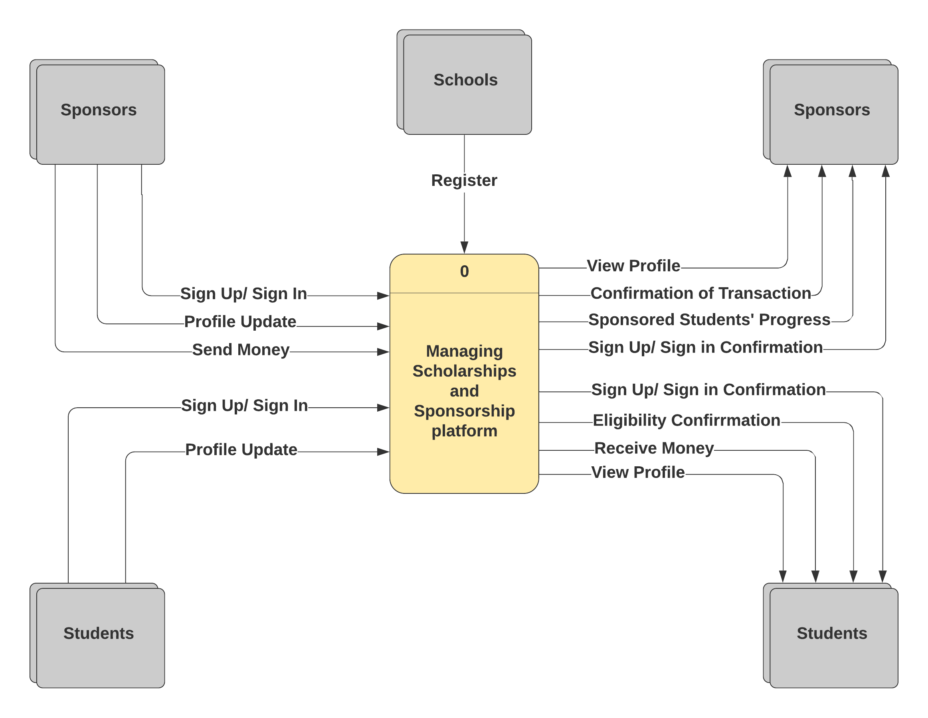
Context Diagram

Slide 4
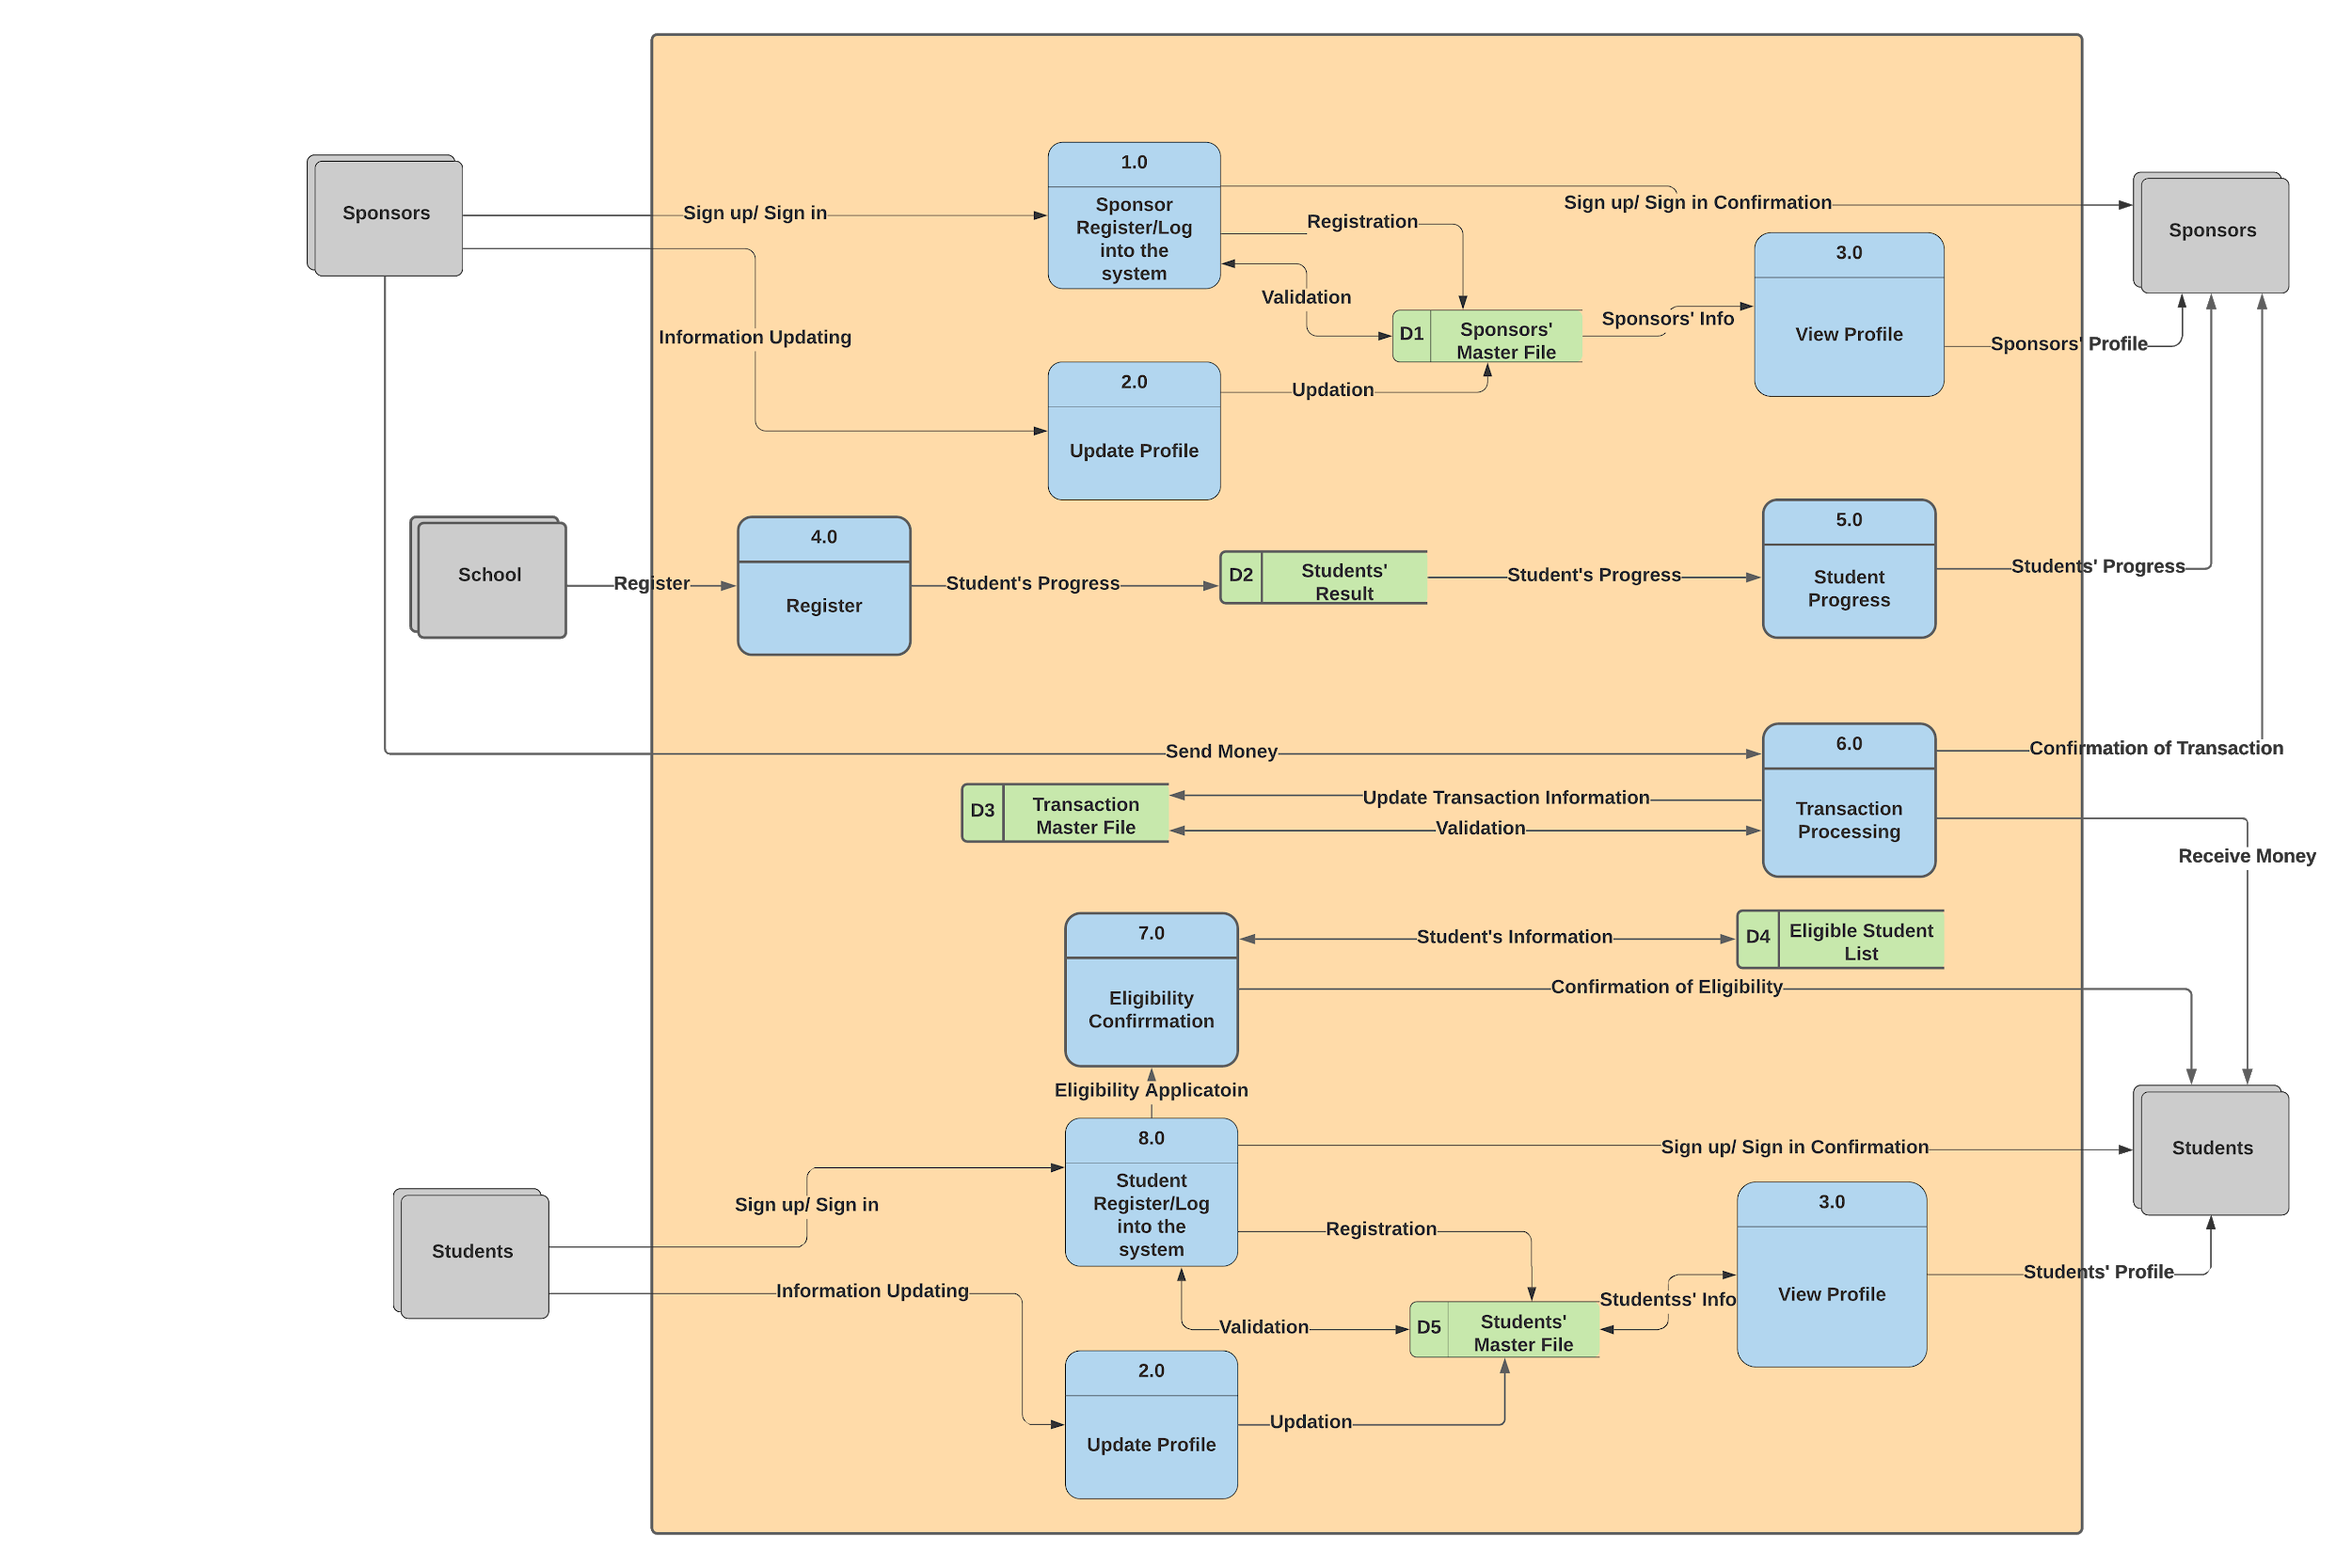
Diagram 0

Slide 5
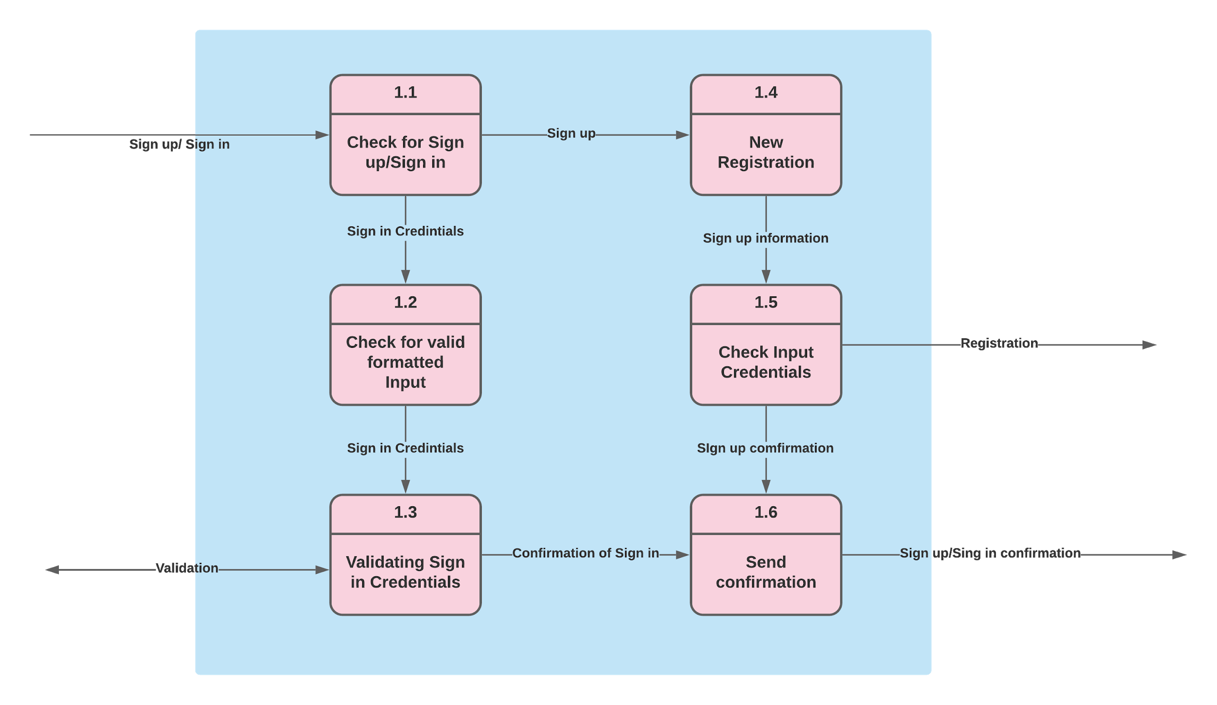
Diagram 1

Slide 6
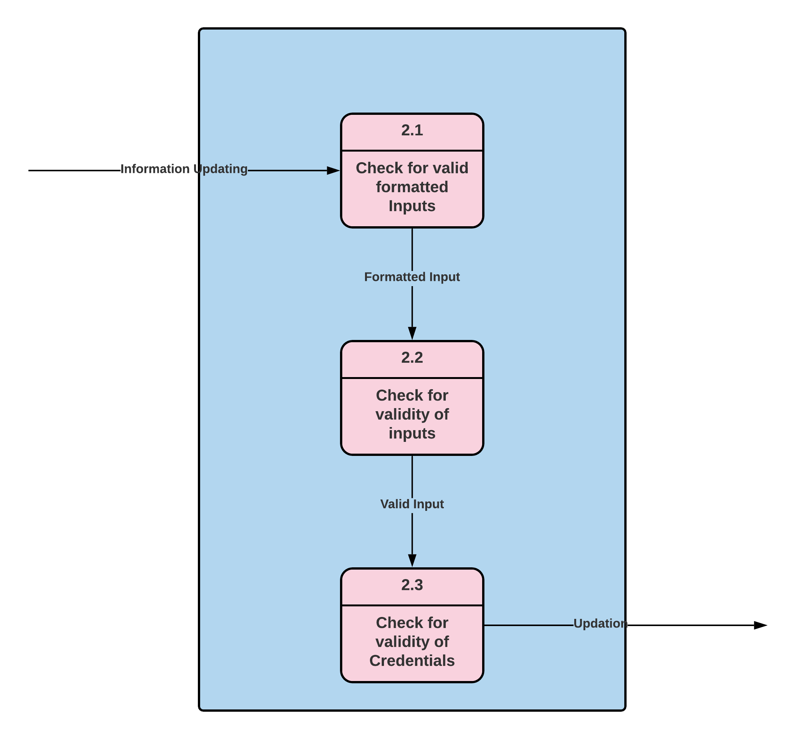
Diagram 2

Slide 7
Thank You

